Slide 1
World Happiness Scores
By: Jon Scheaffer, Alvin Ugochukwu, and Sam Sharp

Slide 2
Data and Explanations
World Happiness Score is the output that is obtained when statistically calculated from many different variables which describe aspects of society in a given country.
The dataset used is from the World Gallup Poll.
Importantly, none of the predictor variables appear to be colinear, which strengthens the argument for the use of multiple linear regression.
The dataset consists of entries for 146 countries, using 6 predictors that each linearly correlate with the World Happiness Score.

Slide 3
Variables and Their Meanings
The following chart explains the variables analyzed (each variable has a maximum value of 10):
Variable Name | Abbv. | Meaning
World Happiness Score | hs | Happiness score, the predicted result from independent variables
GDP per capita | gdp | The GDP of the country in question
Social support | soc | The level of social programs and support available
Healthy life expectancy | hle | The healthy life expectancy of a person in the country
Freedom to make life choices | free | The ability of a person in the country to do what they wish
Generosity | gene | The level of generosity someone experiences in the country
Perceptions of corruption | poc | The level of perceived corruption within institutions of power

Slide 4
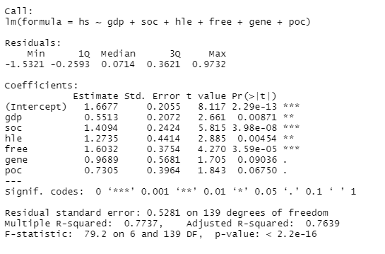
Correlation among Predictor Variables
The overall F-statistic for the data is 79.2. The p-value is 2.2e-16, which indicates that the regression model is significant.
After running a collinearity check on the different independent variables, it is important to note that they do not appear to be strongly correlated at all as none of the variance inflation factors are even greater than 4.

Slide 5
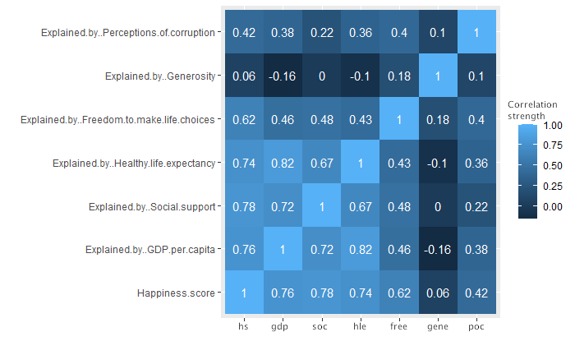
Heatmap of Independent Variable Correlation
Though some cells of the heatmap seem highly correlated with a factor of 1, this is simply due to the variable being compared to itself, which is irrelevant to the overall result.

Slide 6
Conclusions
To test the data’s resulting function for yielding an accurate result, a sample value may be used. Regression Model is significant.
The equation to find a predicted happiness score is:
hs = 1.67 + (0.55)X₁ + (1.41)X₂ + (1.27)X₃ + (1.60)X₄ + (0.97)X₅ + (0.73)X₆

Slide 7


Sources
world happiness report 2022 | Kaggle

